Slide 1
Midlands Track
Coffee and Conversation
DBT Midlands, Africa, Europe and LATAC

Slide 2
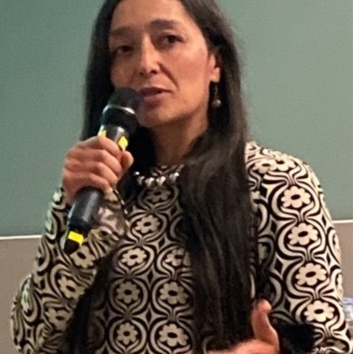
Ana Maria Parada-
Infrastructure Sector Lead for Colombia – Trade, British Embassy Bogotá
DBT Colombia

Slide 3
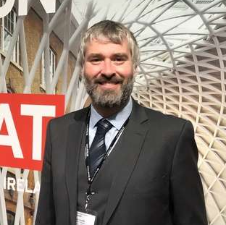
Alan Goodliffe-
Senior Trade Adviser, Infrastructure, Construction and Mobility, British Embassy Stockholm
DBT Sweden

Slide 4
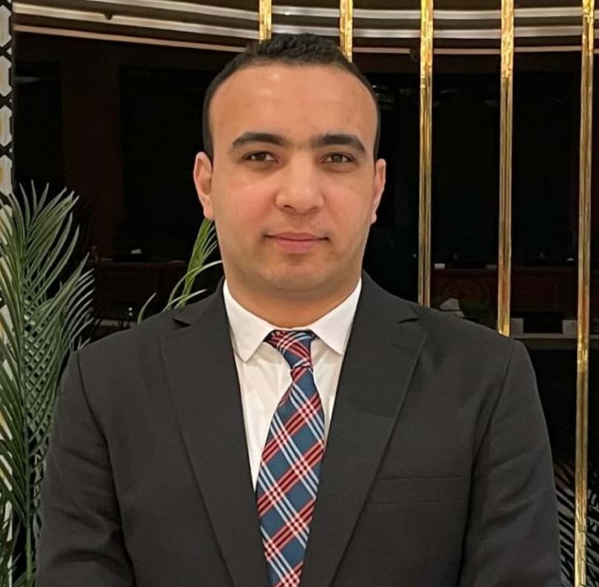
Ahmed Farouk Ali- Senior Trade Adviser- Manufacturing, Digital and Creative Industries Cairo,
DBT Egypt

Slide 5
Contact Details
Midlands Track Microsite https://eu.eventscloud.com/ehome/200278602/about/
DBT In Market Trade Advisers
Ana Maria Parada, DBT Colombia: Ana.Parada@fcdo.gov.uk
Ahmed Farouk Ali, DBT Egypt: Ahmed.Farouk@fcdo.gov.uk
Alan Goodliffe, DBT Sweden: Alan.Goodliffe@fcdo.gov.uk
Midlands Overseas Champions
Claudia Rodriguez, LATAC: Claudia.Rodriguez@fcdo.gov.uk
Shaan Padayachy, Africa: shaan.Padayachy@fcdo.gov.uk
Loubna Choug, Europe: Loubna.choug@fcdo.gov.uk

Slide 6
Contact Details
Homepage of DBT
https://www.great.gov.uk/
Direct link to the contact page
https://www.great.gov.uk/contact/domestic/export-support/
Export Academy- upskill new and existing exporters
https://www.great.gov.uk/export-academy/
Emma Johnson – DBT Midlands International Engagement Manager
emma.johnson@businessandtrade.gov.uk
Andy Smith – DBT Midlands International Engagement Manager
Andy.smith@businessandtrade.gov.uk

Slide 7
DBT Egypt Notes
Merge of Ministry of Transport and Ministry of Industry in Egypt after the last cabinet reshuffle.
Monorail: Financed by UKEF $ 1.7 bn with UK component of Alstom ( 22 stations and 55 KM long), to link New Capital and industrial area of 6 October, trial run done last week and expected to start running by 2025.
Global tender of the Ministry of Transport for manufacturing of locomotives beginning of 25.
Underground:
Abu Qir Metro in Alexandria (21 KM long, 20 stations )
Orascom, Hitachi Rail and Colas Rail signed Sep 24 agreement to upgrade the system of first metro line.
Signalling :
Tender for updating and developing signalling and communication systems and rehabilitating them in 2023 (100 mn Euro finance)
Oct 24, 2 companies arranged tender documents for the development of the “Tanta-Damietta” rail line which will be released soon.
2 main players in the railway sector
NERIC: Private company with share of SCZone who has 300,000 m2 located in East Port Said Industrial Area to establish rolling stock and locomotive plant, in Nov 23, they signed with Transport Ministry to manufacture Manufacturing 500 carriages, including maintenance and spare parts for 15 years, as a first phase out of a total of (1000) carriages with the National Railways Authority. In May 24 signed with EASTERN R&E Korea to Supply and manufacture of railway wagon components and production of freight wagons. https://www.neric.com/
SEMAF: AOI owned it in 2004, in Dec 23 they signed with Nxtium USA and Titan Containers Belgium to manufacture rail wagon used to transport frozen goods, in Oct 24 they got the global certification of ISO 22163:2023 for manufacturing of locomotives and wagons. https://www.aoi.org.eg/en/units/%D9%85%D8%B5%D9%86%D8%B9_%D8%B3%D9%8A%D9%85%D8%A7%D9%81

Slide 8
DBT Sweden Notes P1
Infrastructure
National infrastructure manager is Trafikverket (Swedish Transport Administration) (www.trafikverket.se) – responsible for planning and delivering national rail and road infrastructure
  Divisions: Major Projects, Investment, and Maintenance
  Pure client role – procures services from the market (design, build etc)
  Has an MoU on R&D collaboration with Network Rail (signed in May 2024)
National rail network is about 80% electrified
  Lots of replacements of overhead lines in the pipeline
Chronic underinvestment in maintenance of the past few decades has left the network vulnerable
  Flagship new mainline projects have been scrapped or scaled back in order to release funding for maintenance
  Digital maintenance (condition monitoring, asset management, predictive maintenance being increasingly tested and deployed
ERTMS – being deployed slowly – at current pace, fully deployed in about 2070 – pace will need to quicken
Stockholm County has the Underground and some light rail systems. Underground currently being extended
  A video of the recent supplier day can be viewed here: https://nyatunnelbanan.se/en/procurement/supplier-day/
Some tram systems around the country

Slide 9
DBT Sweden Notes P2
Operations and vehicles
Liberalised market
  Open access system for freight and passenger traffic
  Regional public transport service procured by county councils (regions)
Most common OEMs (in no particular order)
  Alstom / (Bombardier)
  Siemens
  Asea (which was acquired by Bombardier)
  Stadler
  CAF
Operators – passenger
  SJ
  Transdev
  Snälltåget (part of Transdev)
  VR (recently took over some of MTR’s routes)
  MTR
  Arriva
  Keolis
Operators – freight
  Green Cargo
  Hector Rail
  CFL Cargo
  BDX Rail
  LKAB Malmtrafik
  DB Cargo

Slide 10
DBT Sweden Notes Pg 3
Transitio (www.transitio.se) – a kind of ROSCO that is jointly owned by the Swedish county councils – is planning to procure new vehicles:
New Trams for the city of Uppsala. Transitio responsible for the procurement, Region Uppsala is the client. The project is ongoing and official tendering process is expected to start mid- autumn this year. Planned start of traffic late 2029.
New Regional trains for Norrtåg (the 4 regions in the northern part of Sweden). Transitio responsible for the procurement, Norrtåg is the client. The project is ongoing and official tendering process is expected to start during 2025 (a lot depends on large on-going infrastructure projects). Planned start of traffic 2032.
As it stands today the procurements are expected to be for roughly 20 of each type, plus optional vehicles. The Norrtåg-case could be bigger.
You can find a lot of information about Trafikverket's procurement here: https://bransch.trafikverket.se/en/startpage/suppliers/Procurement/

